Slide 1

User Stories – The Art of Writing Agile Requirements
Speakers: Susana Esparza & Raj Indugula Company: LitheSpeed
Website: lithespeed.com
Welcome to the PMI Houston Conference & Expo and Annual Job Fair 2014
• Please set your cell phone to silent mode
• There will be time at the end of this presentation for you to take a few moments to complete the session survey. We value your feedback which allows us to improve this annual event.
1

Slide 2
Agenda for Today’s Workshop
• Introduction
• Overview of Agile/Scrum
• From Vision to Acceptance Criteria
○ Modeling Users & Customers
○ Epics, Features & User Stories
○ Elaborating from Vision to Story
○ Acceptance Criteria & Testable Examples
• Q & A
2

Slide 3

An Introductory Exercise
1. Find a partner.
2. Start telling them about yourself.
3. When they hear something you both have in common, they will say “Me Too!” and find a new partner.
3

Slide 4
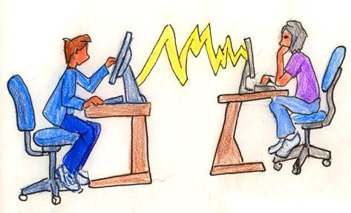
Problem Context: Communication
Business Wants
Development Builds
QA Tests
4

Slide 5

Striking a Balance
Business
Development
5

Slide 6
Overview
Agile & Scrum

Slide 7

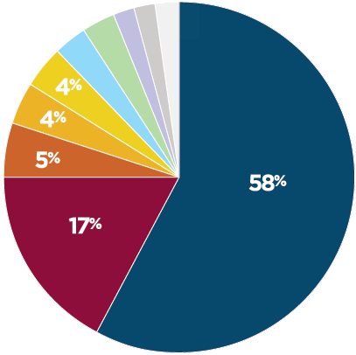
The Agile Landscape
“Agile” describes a number of related methods.
Scrum is the most popular.
• Scrum
Jeff Sutherland & Ken Schwaber
• Extreme Programming (XP)
Scrum
Scrum / XP
Kent Beck, Ward Cunningham, Ron Jeffries
• Kanban
David Anderson
• Scaled Agile Framework (SAFe)
Source: 2010 State of Agile
Dean Leffingwell
Development Survey, VersionOne
7

Slide 8




Dealing with Uncertainty
You don’t need agile if you know what to build, who to build it for, and how to build it
Initial Plan
Empirical methods monitor progress & direct adaptation
Use agile when
you have uncertainty…
What to build: End Uncertainty
How to build it: Means Uncertainty
Who to build it for: User Uncertainty
Better Plan
8

Slide 9












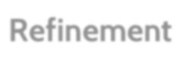

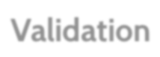


























Ceremonies and Artifacts of Scrum
Sprint Cycle
Initial Planning
Initial Discovery *
Continuous Discovery
In-Sprint Feedback
“Ready” Features For next
Sprint or two
Backlog Refinement
Product Validation
Led by Product Owner with help from Team
Led by Team
Sprint Review
Daily Scrum
Release Planning
Sprint Planning
“Done” Features
For this Sprint
Work
Sprint Retro
Continuous Delivery
Product Backlog
Sprint Backlog
Burndown
* Discovery is not explicitly part of the Scrum Framework
9

Slide 10






























Roles
Vision
ROI/Product Backlog
Release Plans
Trade-Offs
Sprint Planning
Product Owner
Product Backlog
Sprint Backlog
Roles
Team
Shippable Functionality
Daily Scrum
ScrumMaster
Values, Practices, Rules
Deliverables
Process
Retrospective
Blockers
Burndowns
10

Slide 11




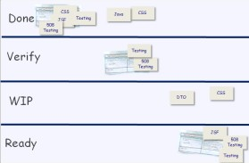

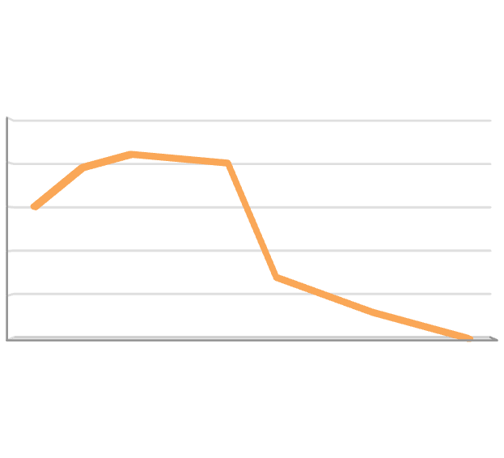








Tools
PB Item
Priority
Size
• Product Backlog
User Story
High
2
Prioritized list of all items (PBI) required
User Story
High
3
to launch a successful product
User Story
High
5
User Story
Medium
2
User Story Medium
PBI Medium
User Story Medium
User Story Medium
PBI Medium
User Story Low
User Story Low
13
8
SB
Item
Priority
• Sprint Backlog
Tasks to get committed PBIs to done within Sprint
8
User Story
High
13
T
ask 1
20
T
ask 2
100
T
ask 3
40
User Story
Medium
• Task Board
Stories and tasks for the Sprint tracked from start to completion
Task 1
Task 2
Task 3 User St Task 1
Task 2
500
400
300
200
100
0
₃₉₀ 420 ₄₁₀ ₄₀₀
300
ory
Low
140 ₁₀₀
• Burndown/burn-up Chart
Visual aid for tracking team progress and forecasting expected completion dates
60
30
0
11

Slide 12
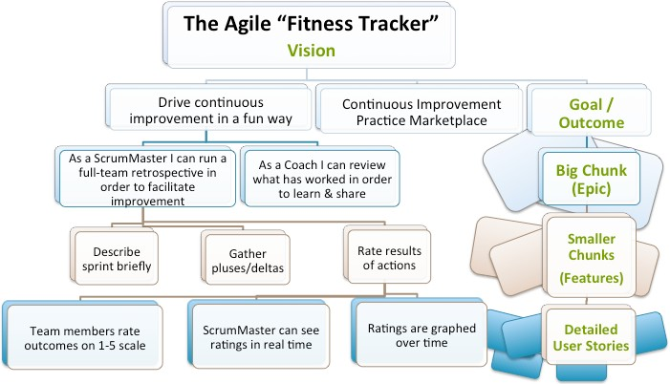
The Big Picture
12

Slide 13
Vision
Aligning Goals & Constraints

Slide 14

Crafting a Vision Statement
For Target Customers Who Statement of Need The Product Name
Is a Category
That Compelling Reason to Buy & Use
Unlike Competition / Alternative
Our Product Differentiator
As described by Geoffrey Moore in Crossing the Chasm
(Thanks to Gabrielle Benefield for the reference)
14

Slide 15
Simulation
Restaurant Finder

Slide 16
Exercise – Prepare a Pitch
Create a Vision Poster for your simulation project with:
1.A product name;
2.A product logo;
3.A product slogan or jingle; and 4.Three (3) compelling reasons to buy
your product.
16

Slide 17
Personas
Customer & User Modeling

Slide 18


Users vs. Customers
Users interact directly with the system
They are important to understand, because:
•Knowledge of current usage patterns helps to design better, more usable systems.
•Unsatisfied users will work around the system, nullifying its advantages and eventually eliminating it.
Customers (sponsors) make buying / adoption decisions
They are also important, because:
•They have their own wish lists that may have little to do with their users’ needs.
•They make the purchasing decisions, so if they aren’t happy, you won’t get in the door.

Slide 19





Looking Across Usage Scenarios
• Personas represent a type of user across usage contexts.
– One member of our current or desired audience in a tangible, less ambiguous way.
– Provide a name, a face, and a description giving us a mental model of our users allowing us to
emphasize with them and predict how they will use our software.
• Level of detail
– Add just enough detail to aid empathy, more details can be distracting.
– Lightweight personas will suffice for many.

Slide 20
User Models Summary
• Use what works user roles, personas, etc., without getting hung up in vocabulary.
• Prioritize your user(s) and prioritize stories for them.
• Post big charts (e.g. personas) in team room to aid
empathy.
• Focus testing and evaluation on the right users, identifying test subjects similar to your models.
• Base models on reality (ethnography / field study):
• Usability Testing
• Observation
• Interviews
• Data Analysis
• Feedback Forms
• Surveys, etc.

Slide 21
Exercise: Create Personas
Who are your most critical personas, or early adopters?
1. List potential stakeholders that would represent the Customers & Users of your product.
2. Prioritize these stakeholders and pick two to elaborate.
3. Create at least two personas by writing brief stories that outline the motivations and goals of these customers or users.

Slide 22
User Stories & the Backlog
Working with Agile “Requirements”

Slide 23


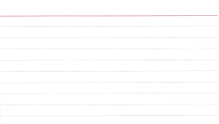






User Stories
The basic user story template is simplistic, it helps us remember a need while providing context.
User Role, Persona
(Who?)
As a customer who drives
I want to find a conveniently located branch
Desired Function
(What?)
So that I can minimize driving time
End Result
(Why?)
What is not specified?
23

Slide 24
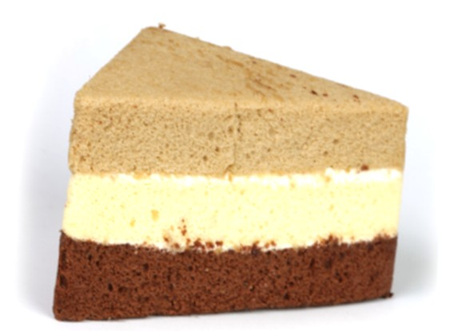
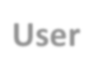
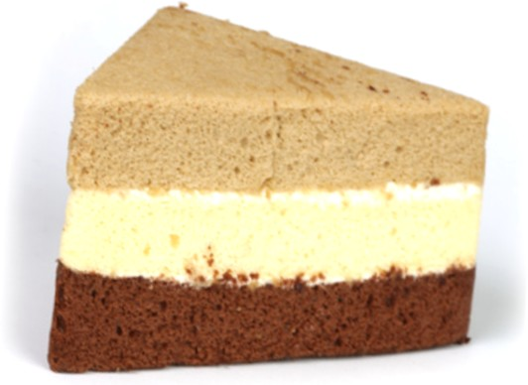
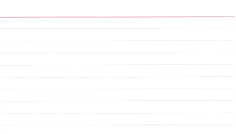





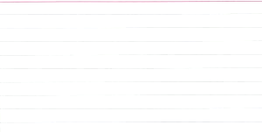
User Stories at a Glance
Key Characteristics
• High-level descriptions of desired functionality and goals
Product Backlog User
As a user I want to create
User Story #2
UI
Business Logic
Persistence
Story
an account so that I can shop online.
Estimate 13 Points
• “Contracts for conversation”, _{Priority 1 (High)}
not all-inclusive requirements
As a user I want to enter my billing information.
Estimate 4 points
Priority 1 (High)
• Pulled into the Sprint Backlog from Product Backlog
• Contain Acceptance Criteria to
define “Done”
As a user I want to
enter my personal information.
Estimate 4 points
Priority 1 (High)
Sprint Backlog
User Stories
• Vertical slices of the system’s functionality
Work in Agile projects is organized by Units of Value, rather than by Architectural Layer.
24

Slide 25





























What Makes a Good Story?
Ron Jeffries’ 3 Cs
Independent
Card
Negotiable
Conversation
Valuable
Confirmation
Estimable
Small
Bill Wake’s INVEST
Testable

Slide 26


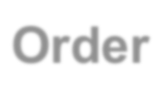








User Stories: Invest - Independent
• If all stories are independent, any one can be picked and delivered in isolation
• For large systems this is nearly impossible!
• But, minimizing, identifying and prioritizing, dependencies can result in a better backlog
• Which user story must come first?
Order Checks
Transfer
Pay Bills
Register
Login
PO: I want “Pay Bills” now!
As prospect
I want to register So that I can execute electronic transactions
As a user
I want to pay bills online
So that I don’t have to write checks

Slide 27


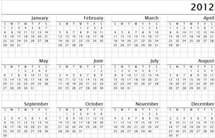




User Stories: Invest - Negotiable
Essence today
• Leaving room for give and take and decide the details when you have more context
– High priorities stories should be more precisely defined
– Low priority stories should have more play
Details later
As a driver
I want to get directions to conveniently located stores
So that I get there quickly
Acceptance Criteria: Show locations on map Show locations on Google Maps
Defer details until you are close to building, in this case update the acceptance criteria

Slide 28


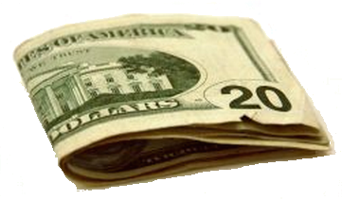

User Stories: Invest - Valuable
The user story must have value to the user and to the business
As a user
I want to have my previous orders stored in the database
So they will be there permanently
As a repeat customer
I want to access old orders So that I can quickly
purchase the same products
again
There is clearly value to the user, but is there value to the business?
As a customer
I want 75% off all purchases
So I can save money

Slide 29









User Stories: Invest – Estimable/Small
• If you can’t estimate it, it is either too large, too vague, too risky, or some combination thereof
• Solutions include adding acceptance criteria,
Easier to estimate, perhaps small enough to complete in a few days
splitting the story, or better defining it
As a customer
I want to find an ATM So that I can make
deposits or with-drawls outside of banking hours
As a customer
I want a self service center So that I can address basic
Too big?
As a customer
I want to find a nearby branch
As a customer
I want to stop payment on check so that I an
prevent a payment made in error
needs 24 by 7 by 365 from
my compute
r
So that I can conduct business in person
Acceptance Criteria:
1. Stop payment on check
2. Find a branch
As a customer
I want to see my canceled checks online
So that I can confirm transactions
3. Find an ATM
4. Order new checkbook
5. Get statement < 2 years old

Slide 30




User Stories: Invest - Testable
• You need clarity on the story specific done criteria
• Solutions include adding acceptance criteria or better defining the story
?????
Have to manually test, but it is clear.
As a registered user
I want a better looking homepage
So that I don’t have to look at something so ugly
Acceptance Criteria:
1. All text is dark color on light
background (no more red on black)
2.Only two different fonts used
(instead of seven)

Slide 31





























Epics, Features, Stories
Stories
Priority
Features
Epics
Product backlog
31

Slide 32
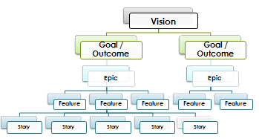
Epics
Epics are high-level features or activities that span Sprints, or even Releases.
• Add a Customer Center for self service.
• Improve database response time by 50%.
Logistics
• The PO works with stakeholders and the Team to create epics that address desired Goals.
• Epics are often defined prior to Release Planning.
• Often months of effort.
32

Slide 33
Features
Features are tangible expressions of functionality, but still too large to build.
• As a Bank Customer, find a branch so that I can deposit checks.
• As a Shopper, set up a mobile wallet so I can pay for purchases via Near Field Communications.
Logistics
• Created by the PO with input from the team
• Often defined prior to Release Planning
• Decomposed over time to smaller Stories
• Typically weeks of effort
33

Slide 34
User Stories
User Stories are ready for the Team to build.
• As a Bank Customer, find a branch near an address so that I can minimize travel.
• As a Shopper, add an account to my mobile wallet so that I can fund it.
Logistics
• Refined in backlog grooming sessions by PO and representatives from Team
• Stories should be well-defined prior to Sprint Planning
• Generally about 1-3 days of effort
34

Slide 35
Non- Functional Requirements (NFRs)
• System-wide nonfunctional requirements may become part of the Definition of Done.
• Articulated as tests
• Serve as design constraints
Search response time will not exceed 10 seconds. All stories will meet Section 508 accessibility guidelines.
• Story-specific NFRs are expressed as
Acceptance Criteria.
35

Slide 36

What User Stories are NOT
User Stories
Requirements
(User Stories
➔ Requirements)
36

Slide 37
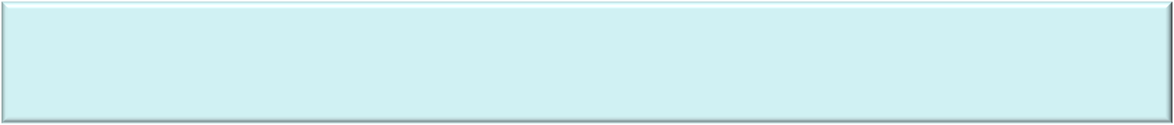








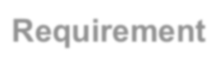







Requirements, More than Just a Story
Context (Project Vision, Business Case, etc.)
=
+
+
Acceptance Criteria
+
Supporting Information
Requirement
User Story
Conversation(s)
Common Understanding of a Need
37

Slide 38


Which Story is Better?
A | B
As a prospect I want to enter my billing information | As a prospect I want to register So I can make purchases online
As a driver I want to find the store with the shortest drive time So I can get there quickly | As a driver I want to find directions to a store on Google Maps So I can get there quickly
As a repeat customer I want to access old orders So that I can rapidly purchase the same products again | As a user I want to have my previous orders stored in the database So they will be there permanently
As a color blind user I want dark text & light background So that I can easily read the text | As a user I want a nice looking site So my aesthetics are satisfied
38

Slide 39

Exercise – Write User Stories
Using the Epics we provided for our awesome restaurant finder app:
• Create at least five Sprint-sized User Stories based on these Epics.
• Use the “As a, I can, so that”
format for the User Stories.
39

Slide 40
Release Planning/Roadmapping
Story Maps

Slide 41






Mapping Releases with Story Maps
User Goals
• Minimize the time needed to access patient records
• Minimize the customer inputs necessary to
access patient records
Access record
Epics
Review history
Update record
Medical Reference
Workflow Sequence
Provide Nurse ID
Provide Patient ID
View history
Enter updates
Release Boundary
Search records
Add comment
Notify of updates
Search reference
Persona
Priority
Night Nurse
Robin
Robin leaves for work at 6pm, after sleeping during the day. She works a 7pm-7am shift in Labor & Delivery, caring for prospective mothers and their babies. Complex computer apps make Robin grumpy.
Sort records
Search history
Reference validation
Filter records
Features & User Stories
Add comment
41

Slide 42
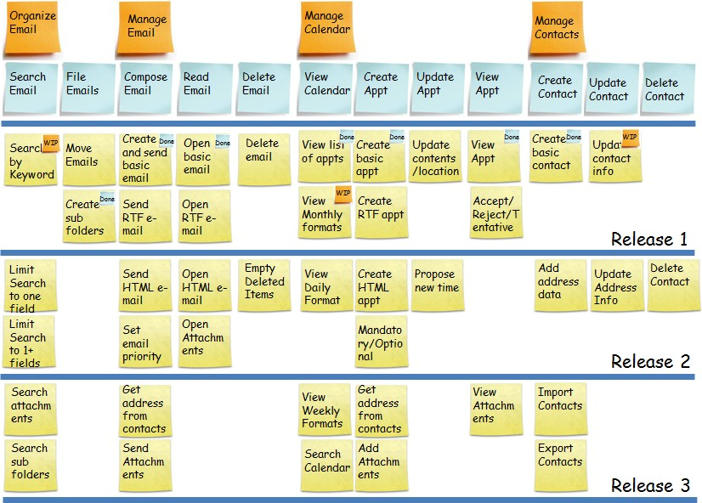
Another Example
Thanks to Winnipeg Agilist for this image
42

Slide 43
Prioritization Parameters
Value is influenced by many things:
• Time sensitivity – Build features that decay in value over time earlier.
• Uncertainty & Risk – Use “spikes” to test market or technical viability for critical, risky features.
• Size – All else being equal, do the shortest first.
• External Dependency – Third party or support group dependencies can be immutable constraints.
43

Slide 44
Exercise – Story Mapping
Plan your first few Releases with a
Story Map.
• Place Epics or High Level Activities at top, in order of their natural workflow as appropriate.
• Place User Stories underneath the Epics that they support, from top to bottom by value.
• Group the stories for your first Release (MVP) and subsequent Releases, describing the targeted benefits of each at a Roadmap level.
44

Slide 45
Product Backlog Management
Refining, Accepting & Testing

Slide 46






Product Backlog Essentials
Adding User Stories
High priority items are better defined
• Anyone can suggest backlog items
• Product Owner prioritizes them
Estimating & Elaborating
• High-priority items are estimated and described most precisely, since they will be worked on first
• Low-priority items are generally estimated and described coarsely
# | Backlog Item | Estimate
1 | Create login screen | 1
 | …
20 | Allow user to browse recently viewed items | 8
 | …
60 | Add personalization | 30 (or so)
Prioritizing
• Ordering is driven mainly by business value and risk reduction.
Low priority items are often “epics”
46

Slide 47














Progressive Elaboration
3-4 Sprints ahead or more
~1-2 Sprints ahead
Current Sprint
Ideation
Maturation
Execution
Market Trends Prototypes Focus Groups User Experience Basic Workflows Vision
Business Outcomes Release Timing and Goals Product Architecture Epics and Features
User Story Decomposition User Story Maturation Acceptance Criteria
Test Cases Dependencies Story Mapping Prioritization Epic Estimation
Backlog Development
Sprint Planning Sprint Estimation Daily Standups
Software Development Testing
Burndowns Documentation Product Demos Retrospectives
Marketing/Sales, Product Management, Product Owners, Architects
Product Owners, Architects, Dev Leads, QA Leads, UX/Analysts
Leads, UX/Analysts, Dev Team Members
47

Slide 48







Maturation of a User Story
User Stories
Created during upfront and ongoing Discovery
As a user
I want to create an account So that I can shop online
Priority – 1 (High) Estimate - 5 Points
Testable Examples (ATDD)
Sprint Pre-Planning (Backlog Grooming)
Acceptance Criteria
Sprint Pre-Planning (Backlog Grooming)
• Phone # in US format, contains no alpha characters, minimum 10 digits
• First name, Last name and email address required
• Email specified in standard format
Sprint Tasks
Sprint Planning
Name | Phone | Email | Valid
John Smith | 215-555-1212 | jsmith@ls.com | TRUE
Smith | 215-555-1212 | jsmith@ls.com | FALSE
John | 215-555-1212 | jsmith@ls.com | FALSE
 | 215-555-1212 | jsmith@ls.com | FALSE
John Smith |  | jsmith@ls.com | FALSE
Smith |  | jsmith@ls.com | FALSE
• Design UI Mock Up
• Write online help text
• Develop CSS/HTML
• Develop validation criteria
• Create database tables
• Code test fixtures
• Code & Test
48

Slide 49




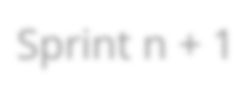
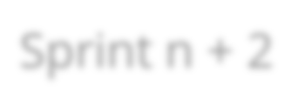





Sample Story Maturation Look-A-Head
The tactical act of getting a story ready is often performed as a two sprint look-a-head by an amigos team
Sprint n
Sprint n + 1
Sprint n + 2
Select User Story 999 for Sprint n
+2
Re-estimate it, sharpen story & acceptance criteria
Create testable example and other supporting material for 999
Get sign off from external parties
Develop User Story 999
The PO and 3+ Amigos look- a-head and select story 999 for inclusion for Sprint n + 2. They do cleanup on the story.
The 3+ Amigos further support the story and the PO gets appropriate sign offs.
Story 999 makes it’s way into a sprint and it is built.
49

Slide 50

Approaches to Splitting Stories
1.To Demonstrate Progress: UX with no validation or save
2.CRUD: Create, report, update & delete (e.g. split of manage)
3.Basic to Advanced: Sort by one field (name), sort by any one field (name, date, etc.), sort by a combination of fields
4.Use Case scenarios: Happy path, alternates, exceptions 5.Workflow steps: Find book, see details, purchase 6.Importance: Credit card, split across cards, automatic billing 6.UI complexity: Manual coordinates, interactive web map 7.Spike and Build: Research credit card processing, implement
50

Slide 51
Split some Stories
1 | As a … I want to manage my widgets
2 | As a report viewer I want to filter my report by any combination of columns
3 | As a possible room renter I want to find and book a room
4 | As a customer I want to pay electronically
51

Slide 52
Split some Stories
5 | As a low budget vacation traveler I want to find flights using a range of dates
6 | As a credit card purchaser I want to pay by Amex, MasterCard, Visa or Discover
7 | As a frequent user I want to personalize my experience
52

Slide 53


Getting to Ready
3+ Amigos (BA, QA, Dev) can serve as a readiness team to look ahead and ensures we are:
1. Ready to prioritize
2. Ready to estimate / right size
3. Ready to build

Slide 54
When is a Story “Ready”?
Definition of “Ready”
• Choose the few items that your team finds most useful in Sprint Planning.
• Confident and quick Sprint Planning and smooth Sprints that produce polished results are your goals.
☑ Interaction Diagrams
❑ Prototypes
❑ Wireframes
☑ Sample Data
☑ Testable Examples
☑ Acceptance Criteria
❑ State Diagrams
☑ Small Enough
❑ Agreement from other teams
❑ Approvals (Compliance, Security, Brand Mgmt, etc.)
❑ Dependency List
❑ Stakeholder signoff

Slide 55
When is a Story “Done”?
Definition of “Done”
• A shared definition and compact between Teams and Stakeholders
• Denotes what stories require to be accepted
• Ideally represents “potentially releasable” or even released state
☑ Acceptance Criteria are met
☑ Cleared by QA
☑ Accepted by Tactical PO
☑ Accepted by Strategic PO
❑ Live for A/B Testing
❑ Final Deployment
❑ Training Script
☑ Pair reviewed
❑ Peer Reviewed
☑ Integrated
❑ Lightweight usability tested
☑ Automated testing in place
☑ User documentation created
☑ Ops documentation created

Slide 56



“Done Done” at Release Level
What are the minimum criteria for each Release?
• Testing/quality targets
• Performance targets
• Operational (e.g. sales/ marketing) deployment goals
• Required documentation & artifacts
• Regulatory compliance targets
Example Release Criteria
• System response on all level 1 functions within 5 seconds
• No Severity 1-3 bugs in Firefox 2+, Chrome, IE 7+ or Safari 3+
• No Severity 1 or 2 bugs found during final month
• Full compliance with accessibility guidelines in Section 508
56

Slide 57
Acceptance Criteria &
Testing

Slide 58




Acceptance Criteria Example
As a user
I can cancel a registration So that I don’t have
to pay
❑ Premium member can cancel the same day without a fee
❑ Non-premium member is charged 50% of first day for a same-day cancellation
❑ Email confirmation is sent to members primary and secondary email addresses
❑ Hotel is notified of any cancellation

Slide 59

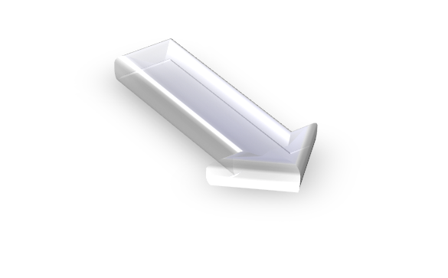



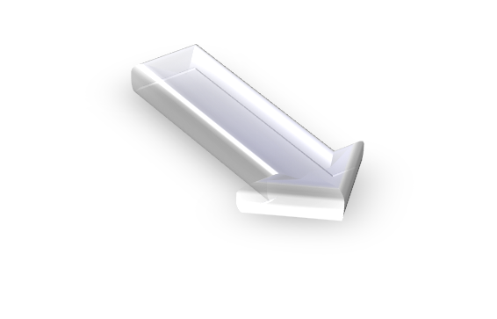

Modern Agile Acceptance Model
Conditions of Satisfaction – Broad Terms
Acceptance Criteria – Further Refined
Examples – Actual scenarios or data
Executable Examples – Ready to automate

Slide 60

Acceptance – Conditions of Satisfaction
Testing a Registration Function
• What constraints should we impose?
• Business stakeholders and PO agree that passwords should not be easy to crack.
Please fill in to register.
Email Address
Password
Register

Slide 61

Acceptance – Acceptance Criteria
Acceptance Criteria, the Details
The PO works with testers and developers from the team, business stakeholders, users or SMEs to come up with this definition of “not easy to crack”:
• Must be at least 8 characters and no more than 12
• Must contain only alphanumerics and the period
• Must contain at least one digit
• Must contain at least one alpha character
Please fill in to register.
Email Address
Password | ????????????
61
61

Slide 62

Acceptance – Examples Written
• Examples, Making it Real
• Actual examples are the ultimate way to communicate requirements
Password | Expec ted | Expected Message | Comment
abc123 | Invalid | You password must be at least 8 characters long, and no more than 12 characters long.
abcdefghi | Invalid | Your password must contain at least one character and one number.
1aaaaaaaaa | Valid |  | Why valid?
ajx972dab | Valid
• Team Members with testing and development expertise take the lead on creating examples, with the Product Owner verifying
• Based on these examples, Acceptance Criteria can be refined
• These criteria act as good starting test cases too

Slide 63
Acceptance – Testable Examples
• Executable Example, Making it Repeatable
• Examples that can be executed are the final step
Given the “Unregistered User” user has navigated to the “register” page
When entering “newuser” in the “Username” field And entering “abc123” in the “Password” field
And entering “abc123” in the “Confirm Password” field
And pressing the “Register” button
Then the text “Thank you for Registering” should appear on page And the URL should end with “use/accountPage”

Slide 64
Acceptance Test Driven Development (ATDD)?
A practice in which the whole team collaboratively discusses acceptance criteria, with examples, and then distills them into a set of concrete acceptance tests before development begins.
- Elisabeth Hendrickson
64
64

Slide 65
ATDD - Key Characteristics
1. Elicit details from the business stakeholder(s) about their expectations
2. Distill acceptance criteria into automatable tests expressed in a natural language
3. Wire the tests to SUT with “glue” code (as part of implementation)
64
65

Slide 66




Automated Acceptance Tests
Tool
(Cucumber, SpecFlow, FitNesse)
Specification expressed in common language
“Glue” code that ties specification to SUT
67
66

Slide 67
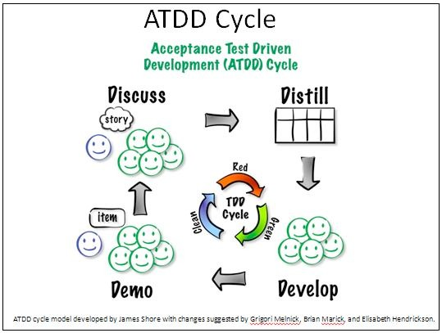
67
67

Slide 68



Exercise – Write acceptance tests
Create testable specifications
Using the User Stories you defined
• Write acceptance criteria for each story
• Create at least two scenarios to act as examples and tests, using this format:
Scenario: Recent Account Activity
Given I am a registered user “Jsmith”
And I am logged in with password “xyx123”
And I have had account activity in the last 45 days
When I click the “Recent Activity” button
Then I should see the “Account Activity” Page
And I should see a list of my activity over the last 45 days

Slide 69

Concluding Thoughts
Common pitfalls with writing user stories
• Forgetting about the User
• Too much Detail
• Lack of Conversation
• No Acceptance Criteria

Slide 70

Contact Information
Speakers: Susana Esparza & Raj Indugula Company: LitheSpeed
Website: www.lithespeed.com Phone: 703.745.9125
E-mail: susana.esparza@lithespeed.com raj.indugula@lithespeed.com
Thank You

Slide 71
Thank you for attending this session. We hope you found this presentation added value to your knowledge of
Project Management.
• Take a few moments to complete the Session Survey. We appreciate and value your feedback.
• Hand in your completed survey to Registration, you will receive a free raffle ticket for one of the drawings to be held in the Vendor Expo (see Conference
Program Guide for details).

